Slide 1
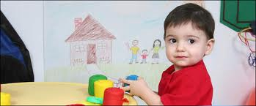
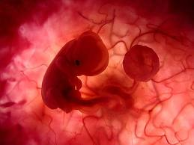
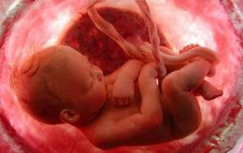
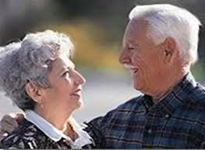
Stages of life

Slide 2
Introduction
All human beings have to pass through this stages and they should learn important
Facts from all they had cross

Slide 3
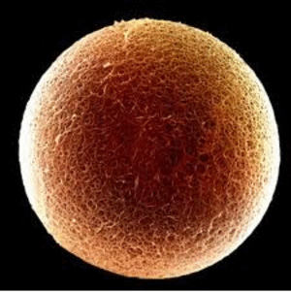
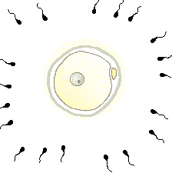
Fertilization
Human Fertilization is the union of human egg and sperm,
The process of fertilization involves a sperm fusing with an ovul.

Slide 4
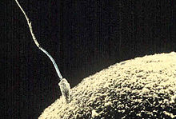
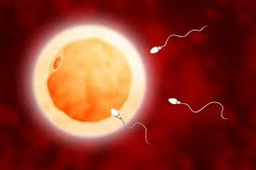

Slide 5
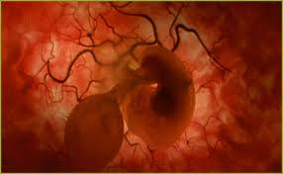
1st month
By 25 days from fertilization the body is developing.

Slide 6
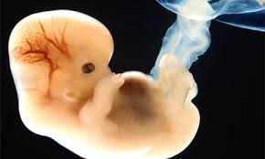
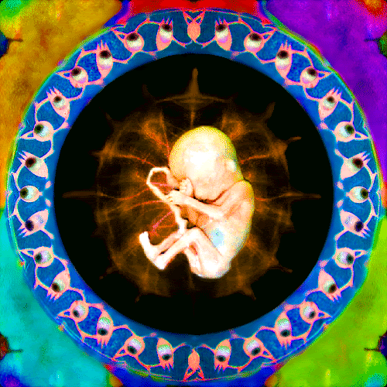

Slide 7
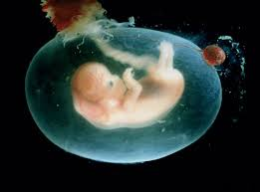
2nd month
Eyes
Ears
Toes
Fingers

Slide 8
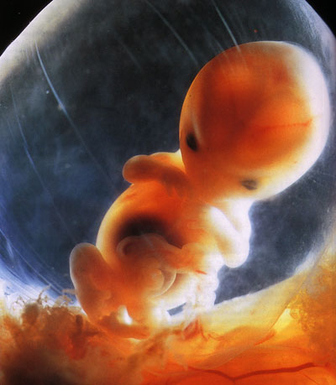
3rd month
Gender
Eyes close

Slide 9
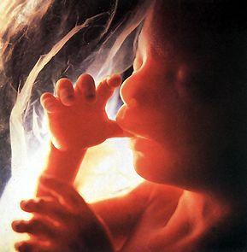
4th -5th month
Hearing
Mother s uterus molds
Sensibility to light

Slide 10
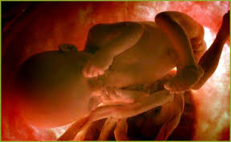
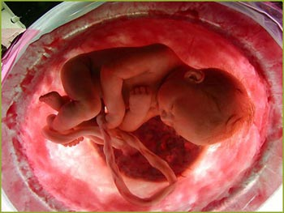
5th and beyond
Walking and sleeping
Reactions

Slide 11
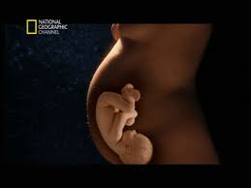
Birth
In the last weeks of pregnancy the baby lies head downwards, as the head is normally the first part to emerge at birth.

Slide 12
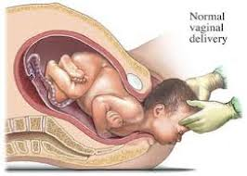
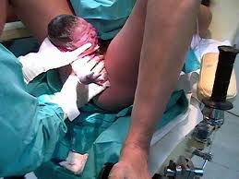

Slide 13
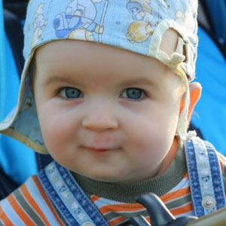
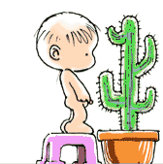
Infancy
It is the earliest period of childhood, especially before the ability to walk has been acquired.

Slide 14
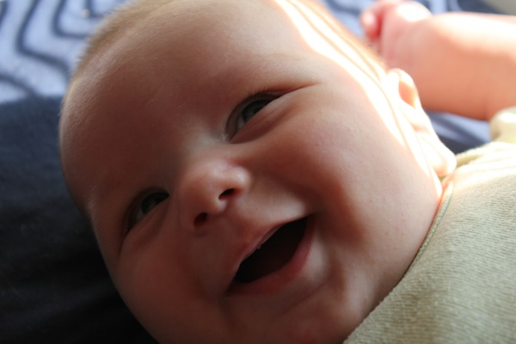
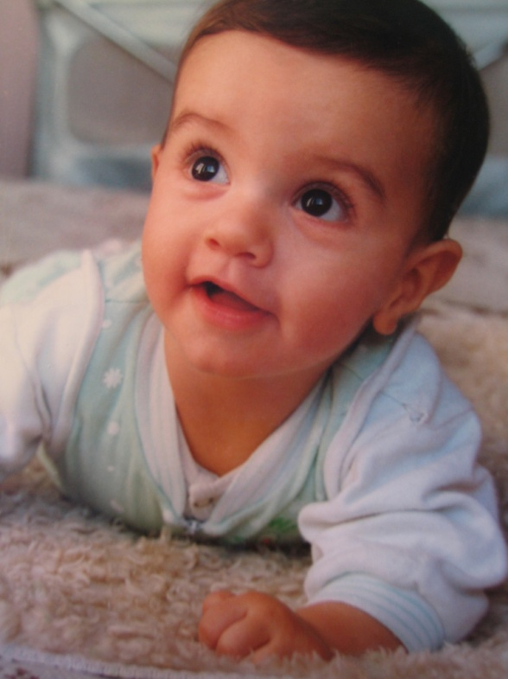
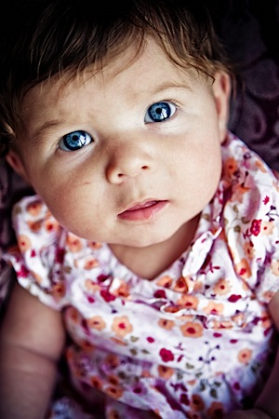

Slide 15
Childhood
Childhood is the age span ranging from birth to adolescence.

Slide 16
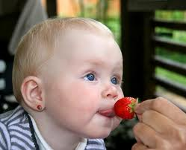

Slide 17
Puberty
Puberty is the time in life when a boy or girl becomes sexually mature.

Slide 18
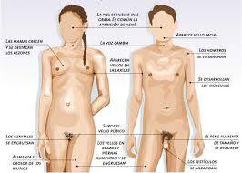

Slide 19
Adolescence
The end of adolescence and the beginning of adulthood varies by country and by function.

Slide 21
Adulthood
It is the stage between 25 and 60 years.

Slide 22
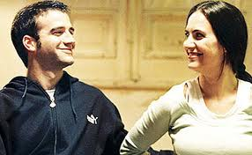

Slide 23
Old age/Elder
It s the last stage of life of a human being; on this stage the person began to get weaker and to get some health problems.

Slide 24
Death
The end of the life

Slide 25
Death is a process consisting of terminal extinction homeostatic process of a living and thus concludes with the end of life.

Slide 26
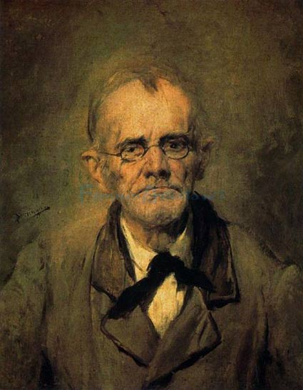
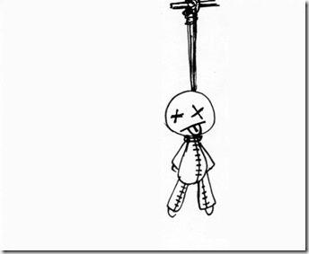
Types of deaths
deseases
old age
assassination

Slide 27
Conclussion
The life can be short for some, it has to be enjoyed day by day until the last one arrives.

Slide 28
The end

